Slide 1
Self-Management of Alcohol Consumption
ADAPT
226-8602

Slide 2
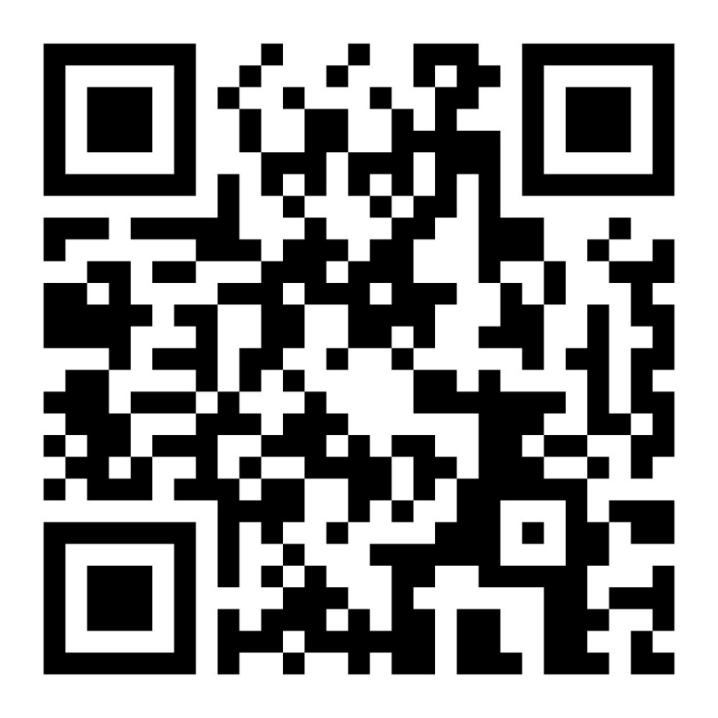
VetChange.org: Self-Help for Alcohol Use
You’re in charge!
Free and confidential
Evidence-based treatment
Robust features and options
Create a personalized action plan
Created by the VA and Boston U.
https://vetchange.org

Slide 3
VetChange App: Self Help for Alcohol Use
Modelled after VetChange.org
Learn new coping skills
Set and track personal goals
Convenience of an app
Used individually or with counseling
Available at Apple & Google Play Store

Slide 4
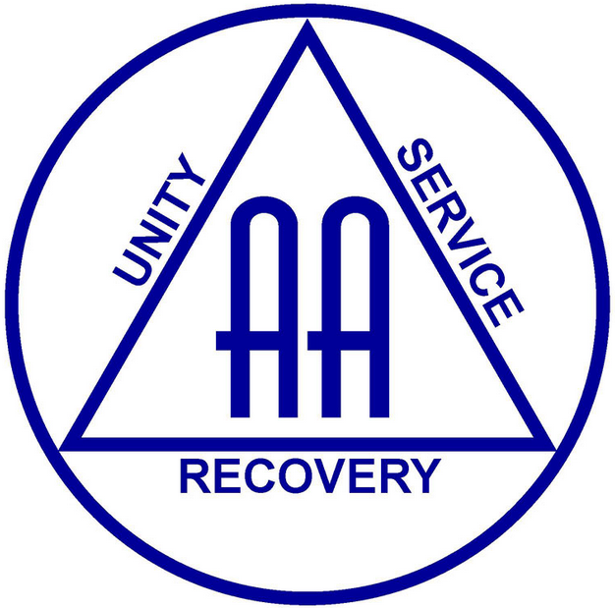
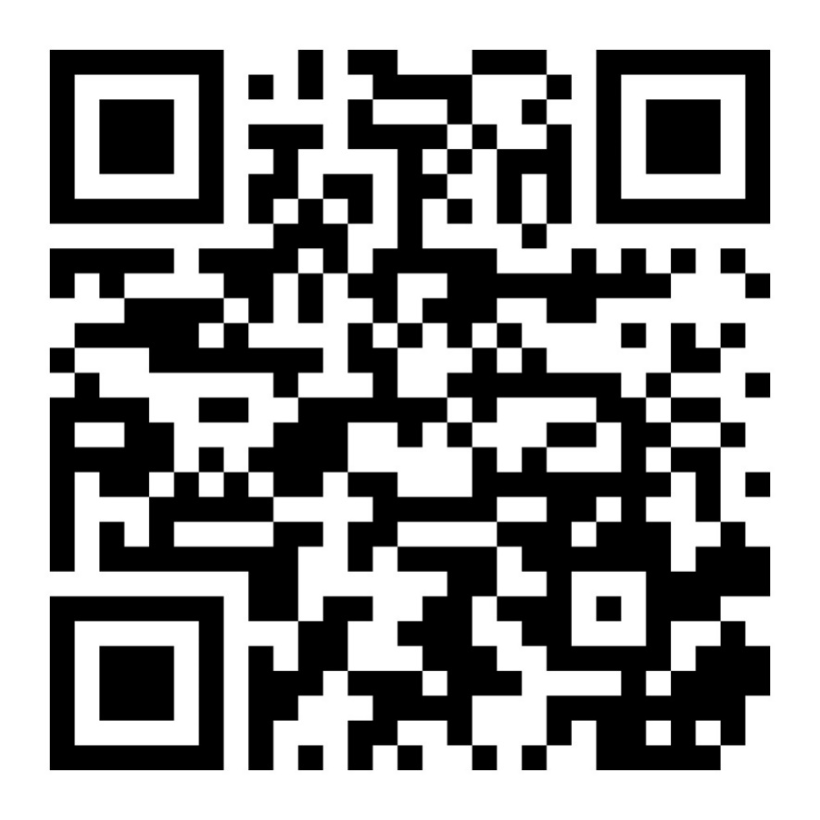
Alcoholics Anonymous: Mutual Help Group
Most well-known 12-step model
Free of charge
Anonymous
Diverse locations/modalities available
Encourages members to recognize a “higher power” to help w/sobriety
https://www.alcoholics-anonymous.org.uk/

Slide 5
SMART Recovery: Mutual Help Groups
Emphasizes evidence-based approach
Free online or in-person meetings
Program goals:
- Motivational enhancement
- Coping with urges
- Managing thoughts, feelings, and behaviors
https://smartrecovery.org.uk/

Slide 6
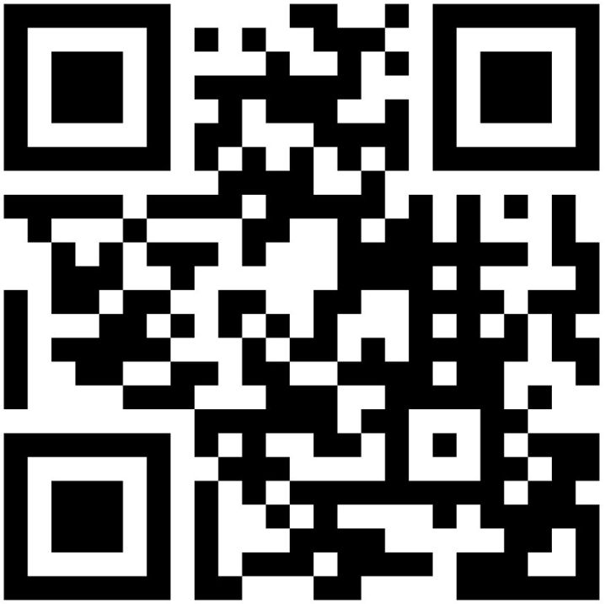
Al-Anon Family Groups: Mutual Help Groups
Help for friends and families of problematic drinkers
Gain support & learn from others
Free and anonymous
In-person or virtual groups
Free helpline available
https://www.al-anonuk.org.uk/

